Slide 1

Python OOP
Course Introduction
SoftUni Team
Technical Trainers
Software University
https://about.softuni.bg/

Slide 2
Table of Contents
Partners
Course Objectives
Training and Team
Course Organization
  Course Infrastructure
  Evaluation Criteria
2

Slide 3
Have a Question?
sli.do
#python-advanced

Slide 4











SoftUni Diamond Partners
4

Slide 5



Educational Partners

Slide 6

Course Objectives

Slide 7
Python OOP Objectives
Understand the OOP paradigm
Creating a hierarchy of classes and inheritance
SOLID Principles
Working with Iterators and Generators
Applying the OOP principles
Component testing
Working with decorators
Design Patterns
7

Slide 8
Practical Programming Exam
3 practical problems for 4 hours:
  Create a simple project that
    Follows the OOP principles
    Implements functionality based on a description
  Test a provided class
Automated judge system with real-time feedback
  Upload a zip project to the judge system
8

Slide 9
Theoretical Exam
You will have 30 minutes once you enter
  Multiple-choice with 1 correct answer
  English
Automated quiz system
Available online the day of the practical exam
  You can submit your answers just one time
9

Slide 10

Training and Team

Slide 11
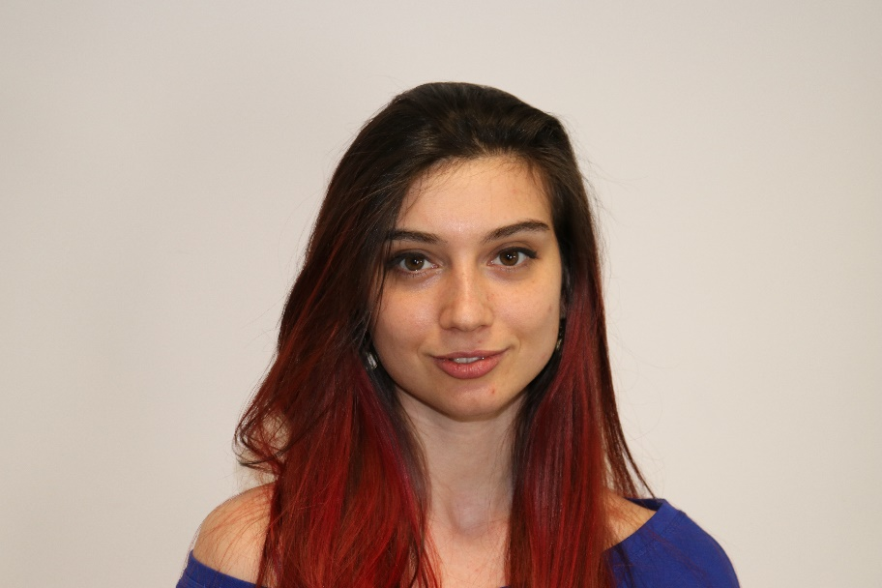
Ines Ivanova
    Senior Software Engineer at Nmible
    Full stack freelance developer
    Python, Django, Flask, FastApi
    C#, Angular
    HTML, CSS
    jQuery, Flask, Docker

Slide 12
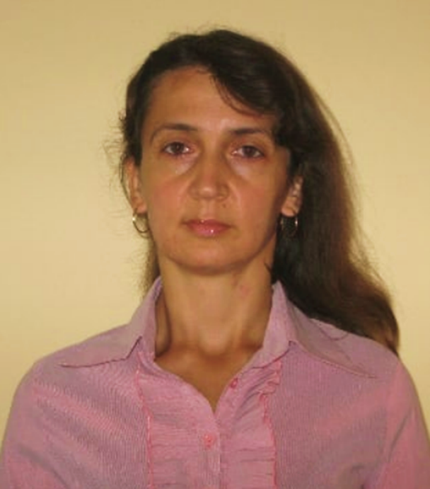
Dani Budinova
    PySW backend developer at Acronis
    Lecturer:
      SW metrics
      QA with automation (Selenium, Apium, SikuliX)
      SW procesess
    Python, Django, monitoring, virtualization
    Automated testing: TDD, BDD, penetration, API and stress

Slide 13
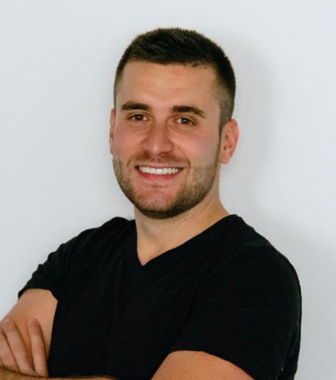
Viktor Ivanov
    Software Engineer at Financial Times
    Interests & expertise:
      Machine Learning
      Distributed cloud systems
      Python, Go, C++

Slide 14

Course Organization

Slide 15
Python Advanced Course
29-Jun-2021
15-Aug-2021
23-Aug-2021
Python OOP
6 weeks * 4 times / week
15 credits
Start: 29-Jun-2021
Theoretical Exam: 15-Aug-2021
Final exam: 15-Aug-2021
Re-Take Exams
Theoretical Exam Retake: 23-Aug-2021
Final Exam Retake : 23-Aug-2021

Slide 16

Homework Assignments & Exercises
Your homework is mainly work in class
  Lesson days → slides + live demos + exercises
  Exercise days → only exercises
How to submit your homework?
  Submitted in the judge system
Do your homework when it's due
  Assignments pile up quickly

Slide 17


SoftUni Certificate
Practical
Exam
100%
Homework
5%
Evaluation
17

Slide 18
CPE Certificate
Practical
Exam
Theoretical
Exam
Evaluation
18

Slide 19


Course Web Site, Forum and FB Group
Official web site:
Softuni Python Community group:
https://softuni.bg/courses/python-oop
https://www.facebook.com/groups/SoftUniPythonCommunity

Slide 20
Questions?
Notes:
20

Slide 21
Trainings @ Software University (SoftUni)
Software University – High-Quality Education, Profession and Job for Software Developers
  softuni.bg, about.softuni.bg
Software University Foundation
  softuni.foundation
Software University @ Facebook
  facebook.com/SoftwareUniversity
Software University Forums
  forum.softuni.bg
21
Notes:
21

Slide 22

License
This course (slides, examples, demos, exercises, homework, documents, videos and other assets) is copyrighted content
Unauthorized copy, reproduction or use is illegal
© SoftUni – https://about.softuni.bg
© Software University – https://softuni.bg
Notes:
22

